Slide 1


Real Estate Pricing- EDA
By- Alankar Saxena

Slide 2

Table Of Contents
01
.
INTRODUCTION
02.
03.
FEATURE ENGINEERING
Visualization of existing
and new features.
MARKET TRENDS & CUSTOMER PREFERENCES
Historical pricing trends and customer preferences and amenities.
Introduction to EDA and Real Estate Sector..

Slide 3

01
.
Introduction
Introduction to EDA and Real Estate Sector.

Slide 4
EDA
Exploratory Data Analysis is the process of analyzing and visualizing data to understand its structure, patterns, and key characteristics before
applying any modeling or statistical techniques.

Slide 5
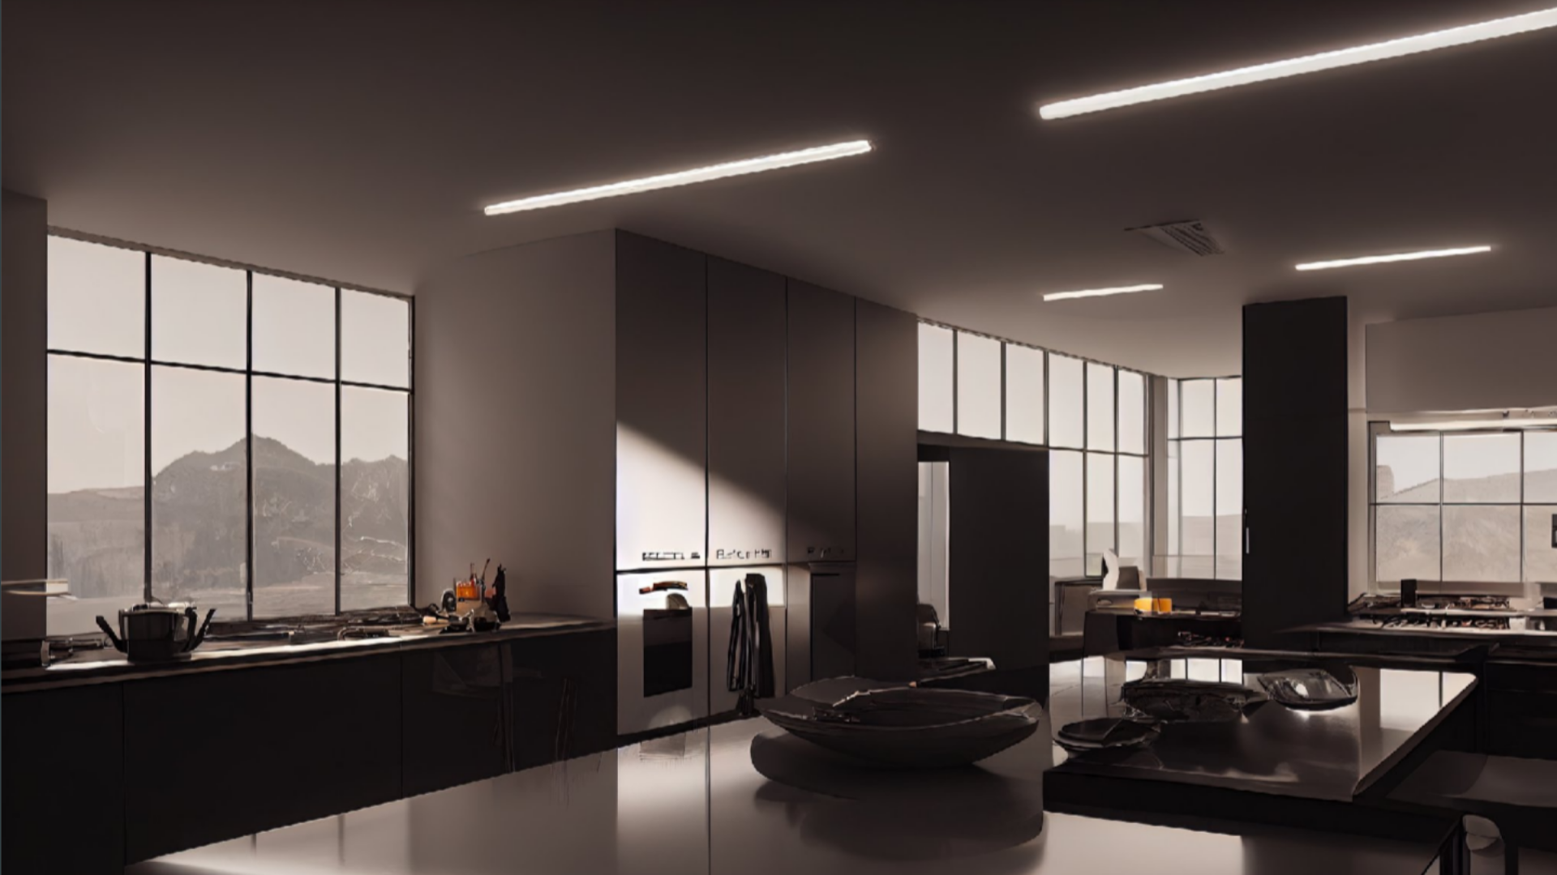
Real Estate
Real estate pricing refers to the process of determining the market value of properties, which include residential, commercial, and industrial assets.
Pricing in real estate is influenced by a combination of factors including location, demand and supply dynamics, economic conditions, property features, and recent comparable sales

Slide 6
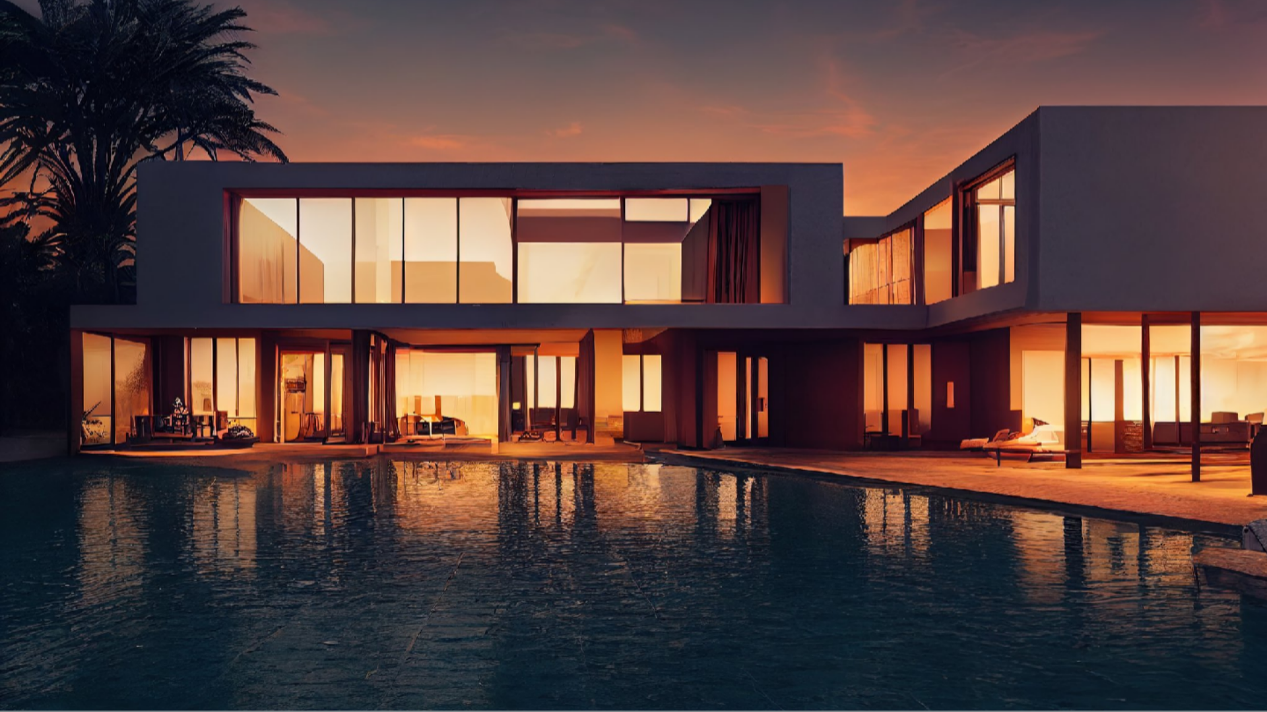
02.
Feature Engineering
Visualization of existing and new features.

Slide 7
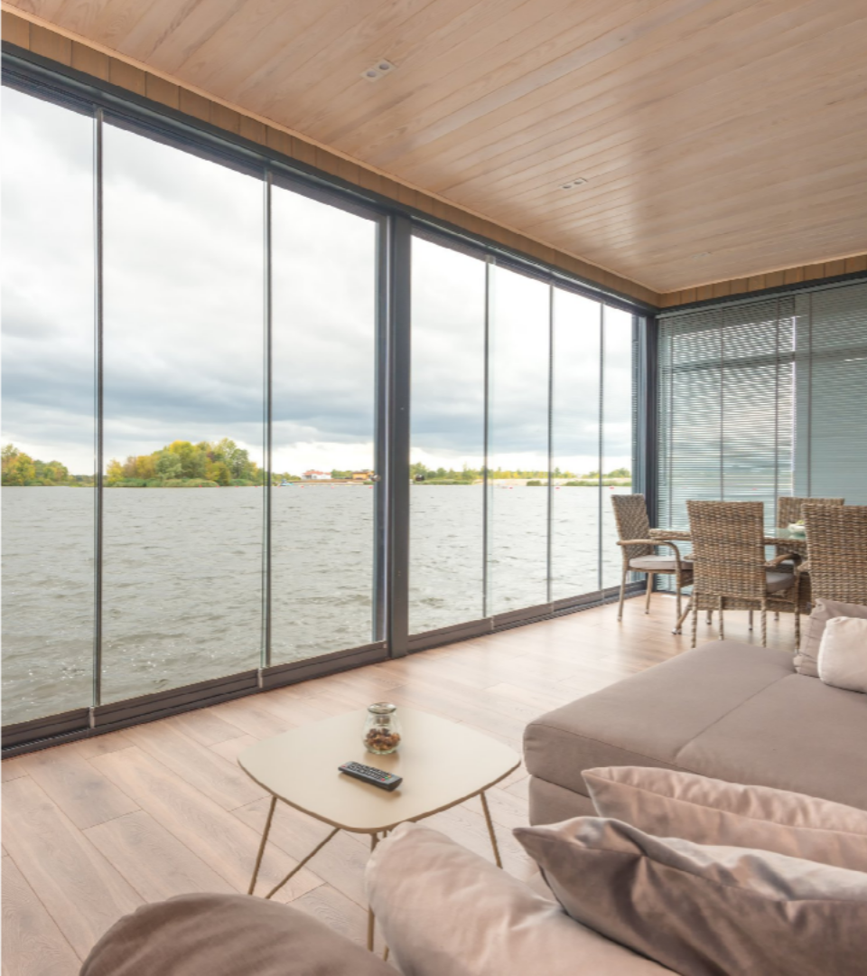
Existing Data Analysis
Key Features-
-Overall quality, External quality, Kitchen quality, Basement quality & Heating quality of the house.
-Living Area, Basement Area & First floor Area.
-Area, Capacity & Type of the garage.
-Year of building and remodeling.
-Number of rooms and bathrooms.
-Neighborhood.
-Type of Masonry.
-Type of Sale.

Slide 8
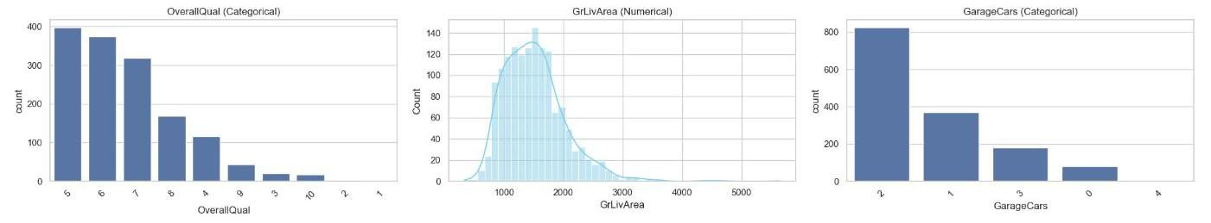
Most prominent features for house sale are overall quality of the house, living area of the house and capacity/area of the garage.
Average quality houses are most famous for being sold.
Houses with living area 1000-2000 sqft are most renowned among all the houses.
Houses with garage capacity of 1 or 2 cars with garage area between 250-600 sqft are preferrable among customers.
Recently built houses are more preferred than old houses.
Houses with average number of rooms(5-8) and 1-2 bathrooms are more preferred.

Slide 9
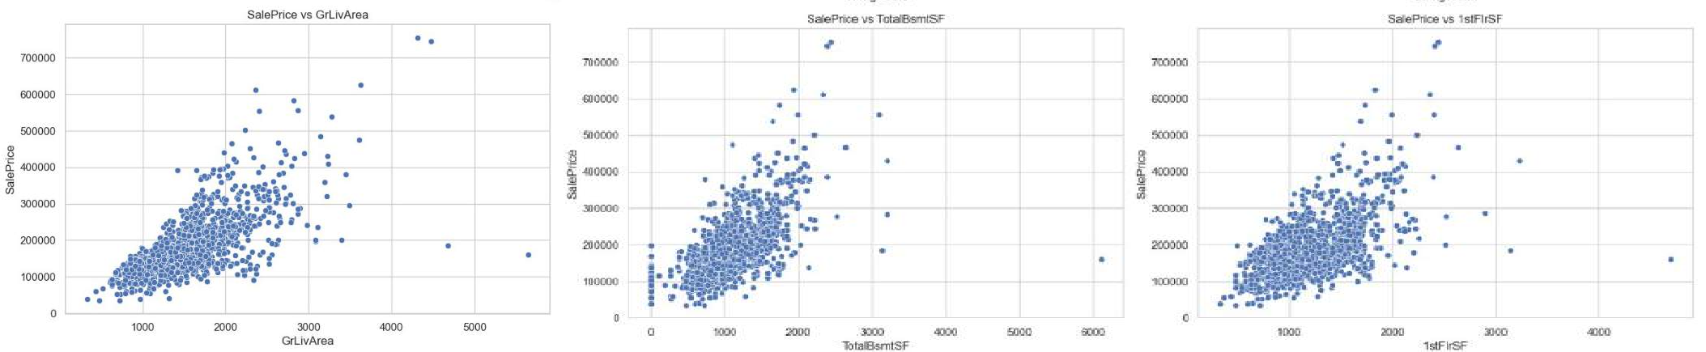
Total living area above ground of the house, Total basement are & First floor area affects positively and very strongly the sale price of the house.
As the area of the house increases, sale price of the house increases drastically.
The costliest houses have total living area between 4000-5000 sqft and basement and first floor area between 2000-3000 sqft.

Slide 10
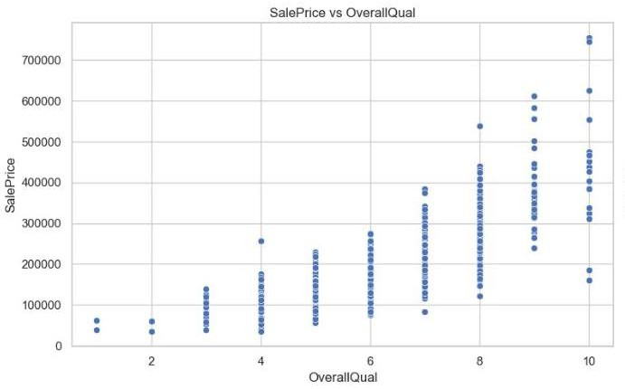
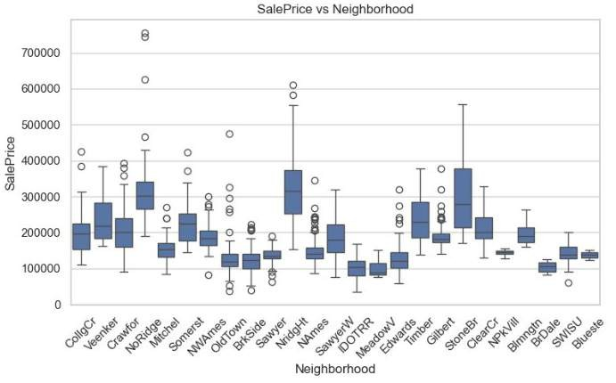
- Overall quality of the house affects the sale price very positively.
- Different neighborhoods have different range of sale price.
- As the rating of overall quality of the house increases, the price of the house also increases.
- Northridge Heights has the highest average sale price while Meadow Village has lowest average sale price.
- Property sold on highest price belong to Northridge.

Slide 11
Feature Engineering
New Features-
-Price of the house per square foot.
-Age of the house and years since remodeled.
-Total porch area, Total basement area and Total living area of the house.
-Total number of bathrooms.
-Is house remodeled or not.
-Does house have garage, basement, fireplace and porch.

Slide 12
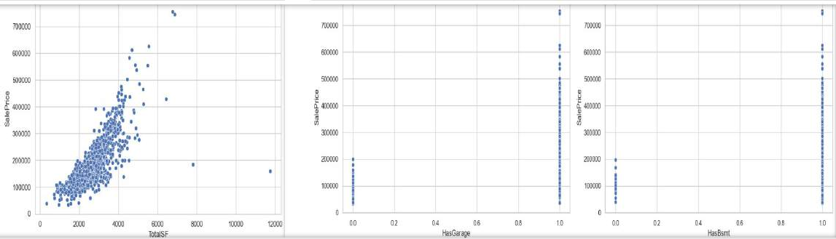
Sale price increases strongly with increase in total living area. Total living area includes the total basement area, Total first floor area and total second floor area.
Houses with garage and with basement have a lot higher sale price than houses with no garage and no basement.

Slide 13

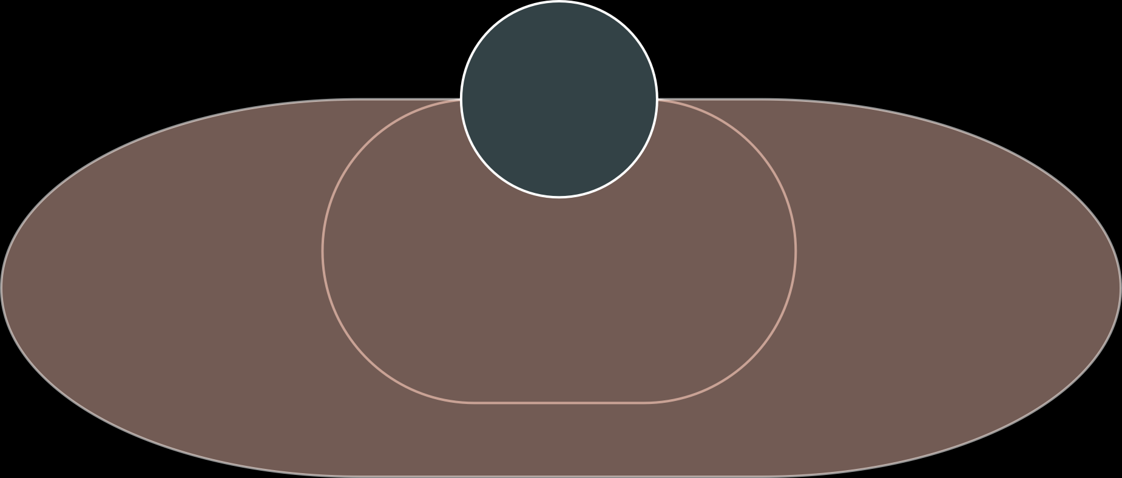
03.
Market Trends and Customer Preferences
Historical pricing trends and customer preferences and amenities.

Slide 14
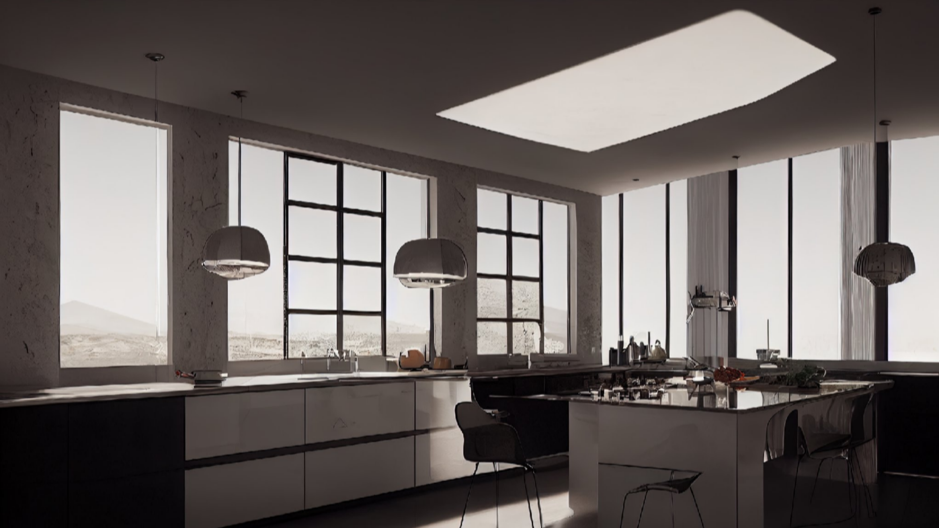
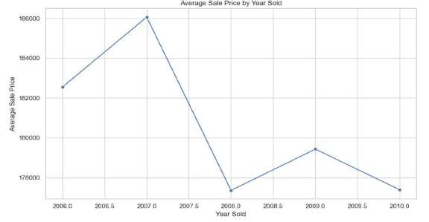
Market Trends
•Average sale price increased from 2006 to 2007, when it was the highest.
•After 2007, sale prices decreased drastically as the result of historic housing crisis between 2007- 2009.
•We only have data till 2010 but from market research we can understand that after 2010 sale price again started to increase.

Slide 15
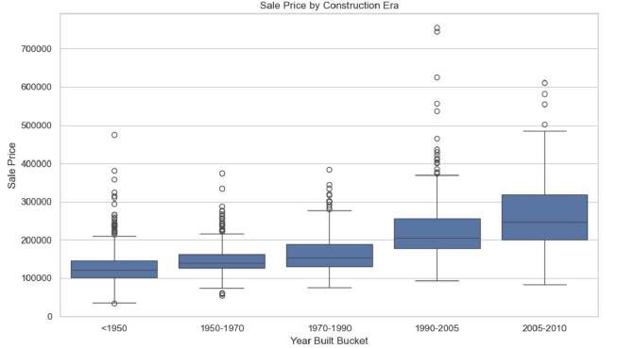
•Average sale price increased with each bucket of years.
•Highest price for a property also increased with time except few exceptions.
•Latest time bucket i.e. 2005-2010 has the highest average sale price.
•The highest recorded sale price were in period 1990-2005

Slide 16
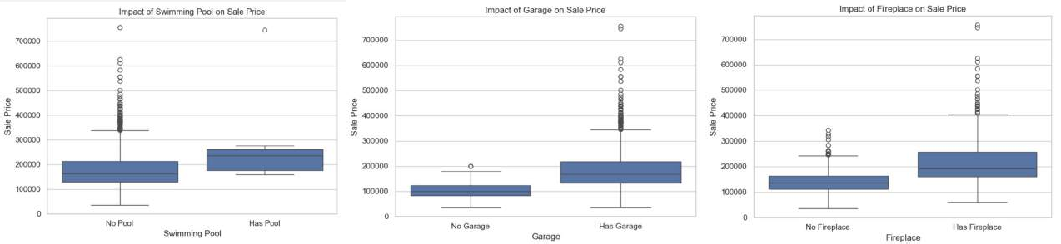
Amenities and Customer Preference
Houses with pool have higher average sale price than houses with no pool, yet houses with no pool have high frequency of being sold at higher prices. It shows that customers do not have big preference for availability of pool at the time of purchasing the house.
Houses with garage have much higher average sale price than houses with no garage.
In contrast to pool availability, garage availability affects a lot to sale price. It shows that availability of garage affect a lot and customers prefer houses with garage and pay high price for it.
Properties with fireplace also have higher average sale price than properties with no fireplace, just like garage availability.
Sale price of properties with fireplace is also consistently very high and have highest sale price as well. It shows that customers prefer houses with fireplace.

Slide 17
THANK YOU
By- Alankar Saxena

